Slide 1


Molten Salt Energy Carrier Model Informed by the Pair Distribution Function
Jacob Numbers¹, Anthony Birri², Nick Termini², Tyler Hamm¹, Troy Munro¹
¹Brigham Young University, Provo, UT
²Oak Ridge National Laboratories, Oak Ridge, TN

Slide 2
Presentation Outline
Molten Salt Thermal Conductivity
Results
Previous Predictive Models
Model of Energy Carriers
Conclusion

Slide 3
Foundational Challenges
Molten Salt Thermal Conductivity (k)
Licensed MSRs
Competitive energy cost
Molten salt thermal conductivity essential for predicting transient reactor behavior^{[1-3]} and designing safe MSRs
Accurate k measurements severely limited by high temperatures, corrosivity, and electrical conductivity of molten salts^{[4]}
Predictive models can help fill in gaps in data, but require understanding fundamental physics for confident models
Experimental Data
Accurate reactor modeling
Optimized MSR design
Predictive Models
Fundamental Physics
Data to validate connection between model and physics
[1] Nunes, V. M. B., M. J. V. Lourenço, F. J. V. Santos, M. L. S. M. Lopes, and C. A. Nieto de Castro. “Accurate Measurement of Physicochemical Properties on Ionic Liquids and Molten Salts.” In Molten Salts and Ionic Liquids, 229–63. John Wiley & Sons, Ltd, 2010. https://doi.org/10.1002/9780470947777.ch17
[2] Smith, A.L., 2022. Structure-property relationships in actinide containing molten salts – A review: Understanding and modelling the chemistry of nuclear fuel salts. Journal of Molecular Liquids 360, 119426. https://doi.org/10.1016/j.molliq.2022.119426
[3] Creasman, S., 2023. Sensitivity Analysis of Thermophysical Properties of Molten Salts using a Molten Salt Demonstration Reactor Model in TRANSFORM. Doctoral Dissertations.
[4] Magnusson, J., Memmott, M., Munro, T., 2020. Review of thermophysical property methods applied to fueled and un-fueled molten salts. Annals of Nuclear Energy 146, 107608. https://doi.org/10.1016/j.anucene.2020.107608
[5] Oak Ridge National Laboratory, U. of South Carolina, T. Besman, N. D. B. Ezell, T. Birri, N. Termini, S. Henderson, and J. Schorne-Pinto. (2024) Molten salt thermal properties database. [Online]. Available: https://mstdb.ornl.gov/

Slide 4
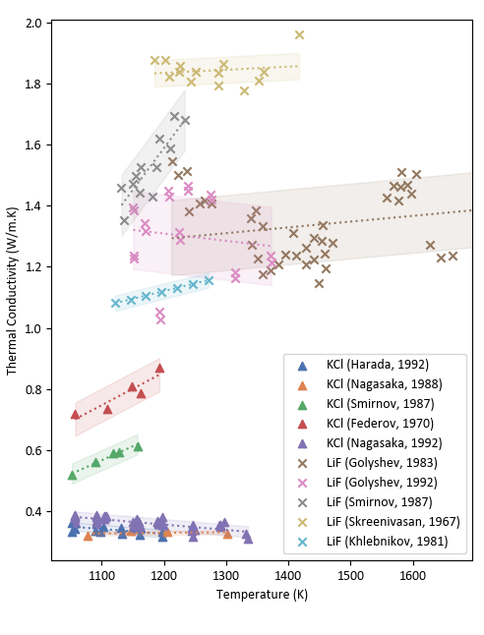
Foundational Challenges
5 actinide-bearing salts
Molten Salt Thermal Conductivity (k)
26 thermal conductivity measurements
Molten salt thermal conductivity essential for predicting transient reactor behavior^{[1-3]} and designing safe MSRs
Accurate k measurements severely limited by high temperatures, corrosivity, and electrical conductivity of molten salts^{[4]}
Predictive models can help fill in gaps in data, but require understanding fundamental physics for confident models
820 salt compositions in MSTDB-TP^{[4]}
18%
12%
9%
4%
Thermal conductivity measurements of LiF and KCl^{4,5,6,7,8,24}
[1] Nunes, V. M. B., M. J. V. Lourenço, F. J. V. Santos, M. L. S. M. Lopes, and C. A. Nieto de Castro. “Accurate Measurement of Physicochemical Properties on Ionic Liquids and Molten Salts.” In Molten Salts and Ionic Liquids, 229–63. John Wiley & Sons, Ltd, 2010. https://doi.org/10.1002/9780470947777.ch17
[2] Smith, A.L., 2022. Structure-property relationships in actinide containing molten salts – A review: Understanding and modelling the chemistry of nuclear fuel salts. Journal of Molecular Liquids 360, 119426. https://doi.org/10.1016/j.molliq.2022.119426
[3] Creasman, S., 2023. Sensitivity Analysis of Thermophysical Properties of Molten Salts using a Molten Salt Demonstration Reactor Model in TRANSFORM. Doctoral Dissertations.
[4] Magnusson, J., Memmott, M., Munro, T., 2020. Review of thermophysical property methods applied to fueled and un-fueled molten salts. Annals of Nuclear Energy 146, 107608. https://doi.org/10.1016/j.anucene.2020.107608
[5] Oak Ridge National Laboratory, U. of South Carolina, T. Besman, N. D. B. Ezell, T. Birri, N. Termini, S. Henderson, and J. Schorne-Pinto. (2024) Molten salt thermal properties database. [Online]. Available: https://mstdb.ornl.gov/

Slide 5
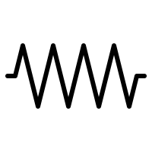
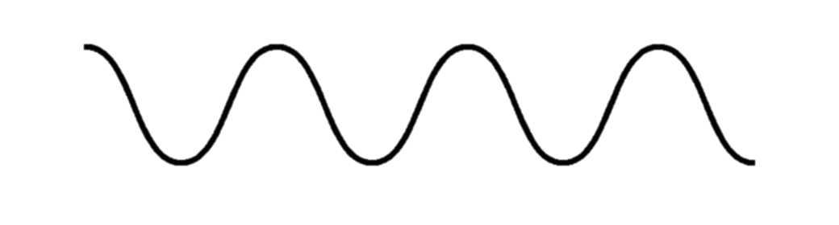
Liquid Thermal Conductivity
Kinetic Theory of Gases
Dilute system – limited intermolecular interactions
Energy stored in individual molecules
Transferal rate via collisions proportional to molecular MFP
More like solids than gases:
Like solids, liquid energy carriers involve collective vibrations (phonon-like), diffusing atoms, electrons
Short-range ordering (SRO) evident in molten salts from pair distribution function (PDF) data
In molten salts, diffusion is limited at short time-scales^{[1]} and only ions carry electric charge (limited free electrons), so vibrational excitations are dominant.
Challenges in modeling:
Lack of long-range order prevents conventional phonon description, and complex interactions limit dilute particle treatment.
Energy Transfer in Liquids?
Phonon Physics of Solids
Significant interactions between molecules
Energy stored in vibrational modes in structure
Energy transferal rate proportional to excitation MFP
[1] Turnbull, A.G., 1961. THE THERMAL CONDUCTIVITY OF MOLTEN SALTS. II. THEORY AND RESULTS FOR PURE SALTS. Australian J. Appl. Sci. Vol: 12.

Slide 6
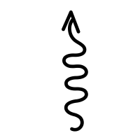
Previous Estimation Approaches
Macroscopic
Thermodynamics
 | Liquid Theory |  |  |  |  | Fitting Methods
 | Phonon Gas Model (Zhao, 2021) (PGM) | Kinetic Theory (Gheribi) |  | Bridgman-type | Chapman-Enskog | Corresponding states, semi-empirical models
 |  | 2014 Empirical Fit (KT_{emp}) | 2024 Kinetic Theory (KT₂₄)
Energy Carriers | Phonon modes, approximated by macro-properties | Relates thermal conductivity to ionic radius proportionality by fitting to KCl data (Nagasaka, 1992) | Scales the Cahill-Poll minimum thermal conductivity according to anion complexity | Dilute gas interactions in a cubic lattice, relates λ to variation in free volumes/angles | Energy transfer occurs via collisions, modified with density and viscosity | Underlying thermal behavior follows across states of matter and certain materials
Temperature Dependence | Negative Based on temp-dependent sound velocity and density | Negative Based on thermal expansivity at melting point scaled with temperature change and composition |  | Negative Based on temp-dependent sound velocity and density | Negative Based on temp-dependent viscosity estimation | Matches temp-dependent behavior of fitted data
Limitations | Unknown phonon freq. distribution requires use of thermodynamic properties | Requires fitting to empirical data to scale the phonon mean free path relationship | Increased deviation with highly disparate ion mass (particularly actinides) | Does not consider dissociated interatomic behavior (prevalent in molten salt ions) | Does not capture the temperature dependence of salts. | May not be able to extrapolate for salt and compositional variation.
Solids
Dilute Gas
Molecular Interactions
Microscopic
[1] Cahill, David G., S. K. Watson, and R. O. Pohl. “Lower Limit to the Thermal Conductivity of Disordered Crystals.” Physical Review B 46, no. 10 (September 1, 1992): 6131–40. https://doi.org/10.1103/PhysRevB.46.6131.
[2] Gheribi, A.E., A.T. Phan, and P. Chartrand. “A Theoretical Framework for Reliable Predictions of Thermal Conductivity of Multicomponent Molten Salt Mixtures: KCl-NaCl-MgCl2 as a Case Study.” Solar Energy Materials and Solar Cells 236 (2022). https://doi.org/10.1016/j.solmat.2021.111478.
[3] Gheribi, Aïmen E., and Patrice Chartrand. “Thermal Conductivity of Molten Salt Mixtures: Theoretical Model Supported by Equilibrium Molecular Dynamics Simulations.” The Journal of Chemical Physics 144, no. 8 (February 26, 2016): 084506. https://doi.org/10.1063/1.4942197.
[4] Gheribi, Aïmen E., Jesus A. Torres, and Patrice Chartrand. “Recommended Values for the Thermal Conductivity of Molten Salts between the Melting and Boiling Points.” Solar Energy Materials and Solar Cells 126 (July 1, 2014): 11–25. https://doi.org/10.1016/j.solmat.2014.03.028.
[5] Kincaid, John F., and Henry Eyring. “Free Volumes and Free Angle Ratios of Molecules in Liquids.” The Journal of Chemical Physics 6, no. 10 (October 1, 1938): 620–29. https://doi.org/10.1063/1.1750134.
[6] Nagasaka, Y., and A. Nagashima. “Corresponding States Correlation for the Thermal Conductivity of Molten Alkali Halides.” International Journal of Thermophysics 14, no. 4 (July 1, 1993): 923–36. https://doi.org/10.1007/BF00502115.
[7] Yang, Huiqiang, Ryan Gallagher, Patrice Chartrand, and Aïmen E. Gheribi. “Development of a Molten Salt Thermal Conductivity Model and Database for Advanced Energy Systems.” Solar Energy 256 (May 15, 2023): 158–78. https://doi.org/10.1016/j.solener.2023.04.009.
[8] Zhao, Andrew Z., Matthew C. Wingert, Renkun Chen, and Javier E. Garay. “Phonon Gas Model for Thermal Conductivity of Dense, Strongly Interacting Liquids.” Journal of Applied Physics 129, no. 23 (June 21, 2021). https://doi.org/10.1063/5.0040734.

Slide 7
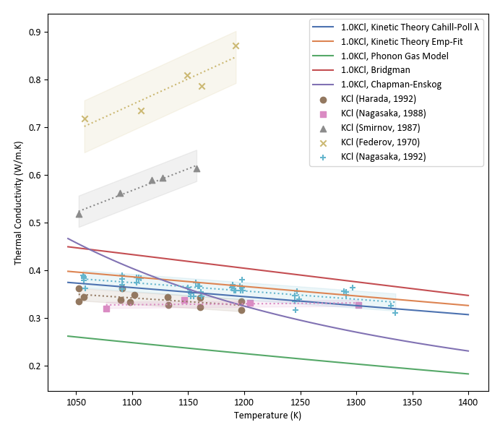
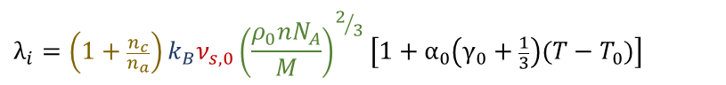
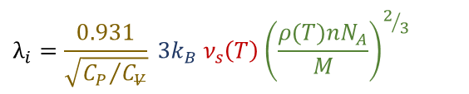
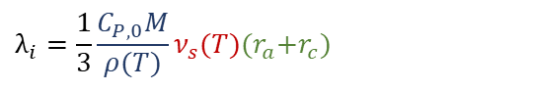
Previous Model Analysis
Models typically describe thermal conductivity in terms of a scale factor of energy storage, group velocity, and MFP of energy carriers
Temp-varying modifier
Gheribi Kinetic Theory, Cahill-Poll λ_{min} (KT_{CPλ}):
$$λ_{i}={\left(1+\frac{n_{c}}{n_{a}}\right)k_{B}ν}_{s,0}{\left(\frac{ρ_{0}nN_{A}}{M}\right)}^{2/3}\left[{1+α}_{0}\left({\text{γ}}_{0}+\frac{1}{3}\right)({T−T}_{0})\right]$$
Adjusts MFP for valency
Zhao Phonon Gas Model (PGM):
$$λ_{i}=\frac{1}{3}{\frac{C_{P,0}M}{ρ(T)}ν}_{s}(T){(r}_{a}+r_{c})$$
Normalized net flux in 1 of 3 dimensions
$$λ_{i}={\frac{0.931}{\sqrt{{C_{P}}/{C_{V}}}}{ 3k}_{B} ν}_{s}\left(T\right){\left(\frac{ρ(T)nN_{A}}{M}\right)}^{2/3}$$
Model performance relative to measurements can help reveal physical mechanisms governing molten salt thermal conductivity
Bridgeman-type:
Adjust to accounts for rotational, vibrational DOF

Slide 8
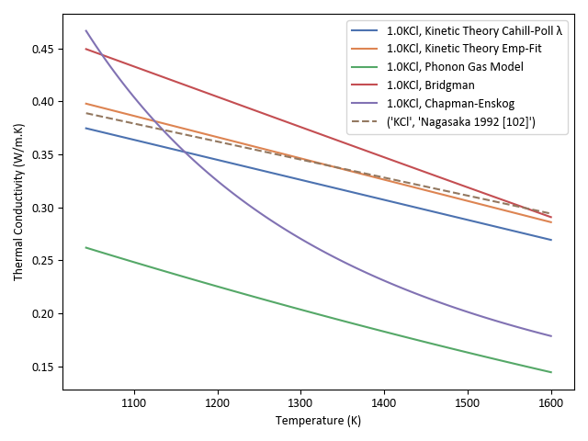
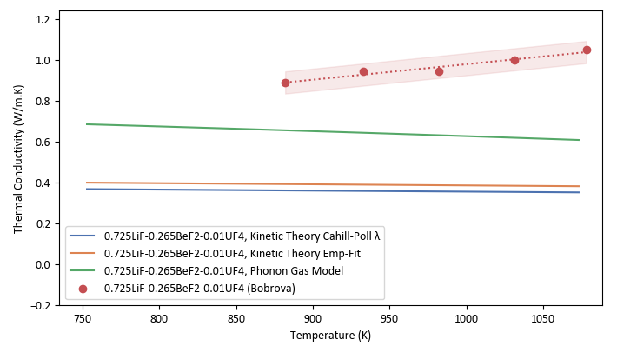
Previous Model Analysis
Zhao – Phonon Gas Model
Zhao – Phonon Gas Model
Gheribi – Kinetic Theory
Strengths
Assumes bulk volumetric properties approximate phonon characteristics per unit volume, conceptually links measured c_{p} and v_{s} to energy carriers.
Weaknesses
Assumes that mean free path is approximated by average interatomic distance—causes underestimations of nearly all salts
Strengths
Temp-dependent adjustment based on thermodynamic link between thermal expansivity and k.
Latest iteration of Gheribi’s kinetic theory accounts for damping to conductivity caused by complexes
Weaknesses
Large ion mass disparity causes significant error due to mass fluctuation term in the case of actinides.
Complexation factor further reduces k for actinide-bearing salts
Other Models
Perform poorly for complex, strongly-interacting, binary liquids
Case study comparisons help clarify correct physical mechanism in various formalisms.
^{See references 1,29,30}
Notes:
KT currently the most successful model

Slide 9
New PDF-informed Thermal Conductivity Model

Slide 10
Energy Carriers in a Coherent Medium
Simplifying the Liquid Approach
The properties of any interacting system are governed by its excitations—the energy carriers^{[1]}.
Two general principles
1. Heat is transferred by some dominant form of energy carrier(s)
2. These propagate with effective properties while coherent medium
Hot
x+λ
Electrons
Metal
Mean free path before collision (energy transfer)
x=0
Phonons
Perfect crystal
x-λ
Atoms
Empty space
Monatomic, dilute gas
Photons
Transparent Solid
x
Once medium coherence ends (crystal defect, collision between atoms, etc.) the energy carrier transfers its energy to new carrier
Cold
y
z
The spatial and temporal extent of coherence determines mean free path
[1] Landau, Lev Davidovich, and Evgeny Mikhailovich Lifshitz. Course of Theoretical Physics. Vol. 5, Statistical Physics, Part 1. Pergamon Press, 1970.
Notes:
I had the priviledge of helping conduct thermal conductivity measurements of NaCl-UCl3 using the variable gap apparatus, which was designed by Ryan Gallagher. It’s been developed by Nick Termini and the team at ORNL to include an extensive Helium calibration method to better characterize it’s measurements. Can provide large temperature range and a confident temperature due to its inherent variable gap design.
These measurements of a similar salt were also conducted using LFA at Argonne national laboratory, which obtains similar reference values at the melting temperature.
KT underestimates these for reasons we just discussed, but note how PGM matches closely with measurements.
Now, why does PGM underestimate pure alkali-halides and mixtures but appropriately predict higher concentrations of actinides? Again, the biggest assumption we think we make with PGM (and most models really) is in calculating the mean free path. PGM puts it simply at the interatomic distance, it may be that this becomes more accurate for complexing salts with actinides.
Obtaining more compositional studies of actinide salts that capture the temperature dependency is vital to answering these questions.

Slide 11
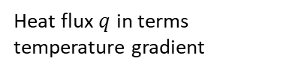
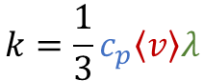
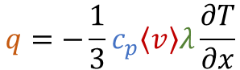
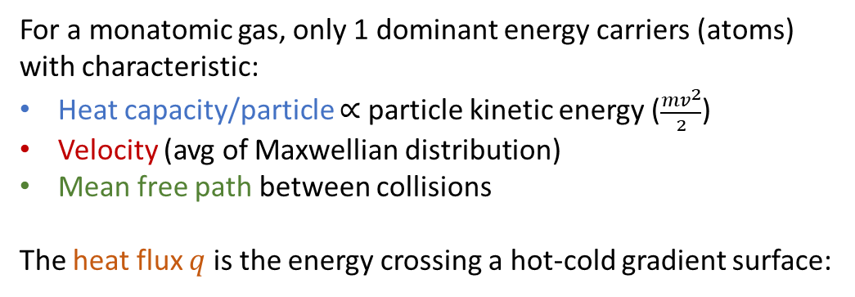
Energy Carriers in a Coherent Medium
Kinetic Theory of Gases
For a monatomic gas, only 1 dominant energy carriers (atoms) with characteristic:
Heat capacity/particle $∝$ particle kinetic energy ($\frac{{mv}^{2}}{2}$)
Velocity (avg of Maxwellian distribution)
Mean free path between collisions
The heat flux $q$ is the energy crossing a hot-cold gradient surface:
Hot
x+λ
Mean free path before collision (energy transfer)
x=0
$$q=−\frac{1}{3}c_{p}\left\langle v\right\rangle λ\frac{∂T}{∂x}$$
Heat flux $q$ in terms temperature gradient
x-λ
Monatomic, dilute gas
x
$$k=\frac{1}{3}c_{p}\left\langle v\right\rangle λ$$
Thermal conductivity in terms of energy carrier properties
Cold
y
z

Slide 12
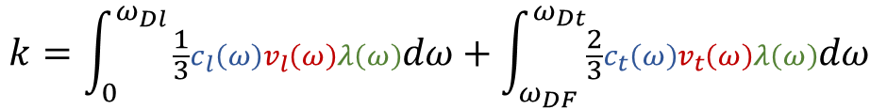
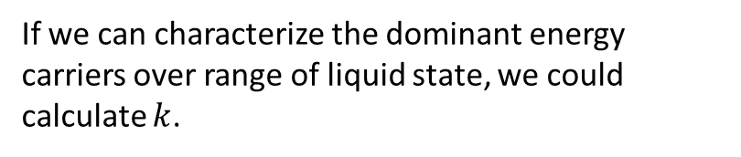
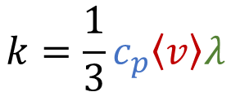
Energy Carriers in a Coherent Medium
Analogy to General Energy Carriers
If we can characterize the dominant energy carriers over range of liquid state, we could calculate $k$.
$$k=\frac{1}{3}c_{p}\left\langle v\right\rangle λ$$
Exactly what the phonon thermal conductivity model describes — integrates properties across phonon frequencies.
Increasing temperature
2 transverse phonon modes (generally negligible in liquids, high Frenkel frequency)^{[2]}
1 longitudinal phonon mode
$$k=\int_{0}^{ω_{Dl}}{\frac{1}{3}c_{l}\left(ω\right)v_{l}\left(ω\right)λ\left(ω\right)dω+\int_{ω_{DF}}^{ω_{Dt}}{\frac{2}{3}c_{t}\left(ω\right)v_{t}\left(ω\right)λ\left(ω\right)dω }}$$
But in liquids, there is a variable phase space^{[1]}, i.e. as temperature increases, viscosity/diffusion limit phonon wavelengths
[1] Trachenko, K., 2023. Theory of Liquids: From Excitations to Thermodynamics. Cambridge University Press, Cambridge. https://doi.org/10.1017/9781009355483
[2] Frenkel, J., 1946. Kinetic theory of liquids, International series of monographs on physics. Clarendon Press, Oxford.
Notes:
I had the priviledge of helping conduct thermal conductivity measurements of NaCl-UCl3 using the variable gap apparatus, which was designed by Ryan Gallagher. It’s been developed by Nick Termini and the team at ORNL to include an extensive Helium calibration method to better characterize it’s measurements. Can provide large temperature range and a confident temperature due to its inherent variable gap design.
These measurements of a similar salt were also conducted using LFA at Argonne national laboratory, which obtains similar reference values at the melting temperature.
KT underestimates these for reasons we just discussed, but note how PGM matches closely with measurements.
Now, why does PGM underestimate pure alkali-halides and mixtures but appropriately predict higher concentrations of actinides? Again, the biggest assumption we think we make with PGM (and most models really) is in calculating the mean free path. PGM puts it simply at the interatomic distance, it may be that this becomes more accurate for complexing salts with actinides.
Obtaining more compositional studies of actinide salts that capture the temperature dependency is vital to answering these questions.

Slide 13
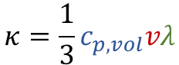
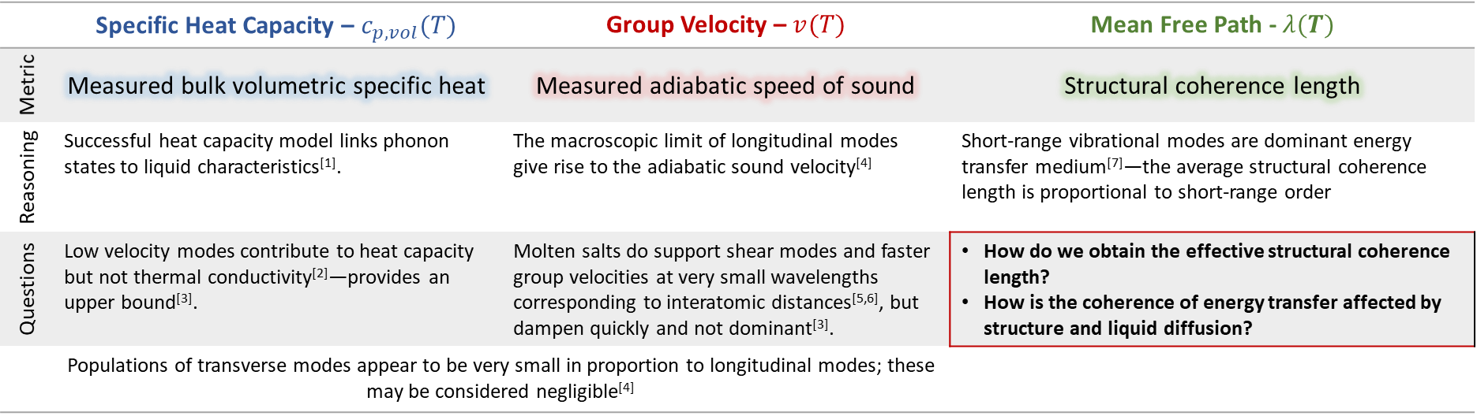
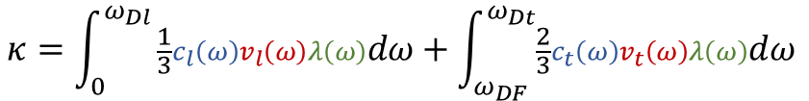
Properties—Macro to Micro
2 transverse phonon modes (generally negligible in liquids, high Frenkel frequency)
1 longitudinal phonon mode
Characterizing Energy Carriers
$$κ=\int_{0}^{ω_{Dl}}{\frac{1}{3}c_{l}\left(ω\right)v_{l}\left(ω\right)λ\left(ω\right)dω+\int_{ω_{DF}}^{ω_{Dt}}{\frac{2}{3}c_{t}\left(ω\right)v_{t}\left(ω\right)λ\left(ω\right)dω }}$$
What temperature and composition-dependent, measurable parameters characterize the dominant energy carriers?
$$κ=\frac{1}{3}c_{p,vol}vλ$$
Assuming effective properties of energy carriers, neglecting transverse modes
 | Specific Heat Capacity – $c_{p,vol}(T)$ | Group Velocity – $v(T)$ | Mean Free Path - $λ(T)$
Metric | Measured bulk volumetric specific heat | Measured adiabatic speed of sound | Structural coherence length
Reasoning | Successful heat capacity model links phonon states to liquid characteristics^{[1]}. | The macroscopic limit of longitudinal modes give rise to the adiabatic sound velocity^{[4]} | Short-range vibrational modes are dominant energy transfer medium^{[7]}—the average structural coherence length is proportional to short-range order
Questions | Low velocity modes contribute to heat capacity but not thermal conductivity^{[2]}—provides an upper bound^{[3]}. | Molten salts do support shear modes and faster group velocities at very small wavelengths corresponding to interatomic distances^{[5,6]}, but dampen quickly and not dominant^{[3]}. | How do we obtain the effective structural coherence length? How is the coherence of energy transfer affected by structure and liquid diffusion?
 | Populations of transverse modes appear to be very small in proportion to longitudinal modes; these may be considered negligible^{[4]}
[1] K. Trachenko, “Heat capacity of liquids: An approach from the solid phase,” Phys. Rev. B, vol. 78, no. 10, p. 104201, Sep. 2008, doi: 10.1103/PhysRevB.78.104201.
[2] D. G. Cahill, S. K. Watson, and R. O. Pohl, “Lower limit to the thermal conductivity of disordered crystals,” Phys. Rev. B, vol. 46, no. 10, pp. 6131–6140, Sep. 1992, doi: 10.1103/PhysRevB.46.6131.
[3] Chen, G., 2005. Nanoscale Energy Transport and Conversion: A Parallel Treatment of Electrons, Molecules, Phonons, and Photons. Oxford University Press.
[4] A. Z. Zhao, M. C. Wingert, R. Chen, and J. E. Garay, “Phonon gas model for thermal conductivity of dense, strongly interacting liquids,” Journal of Applied Physics, vol. 129, no. 23, Jun. 2021, doi: 10.1063/5.0040734.
[5] K. Trachenko, Theory of Liquids: From Excitations to Thermodynamics. Cambridge: Cambridge University Press, 2023. doi: 10.1017/9781009355483.
[6] F. Demmel, S. Hosokawa, and W. C. Pilgrim, “Collective particle motions in molten KCl,” Journal of Alloys and Compounds, vol. 452, no. 1, pp. 143–148, Mar. 2008, doi: 10.1016/j.jallcom.2006.10.167.
[7] K. Cornwell, “The thermal conductivity of molten salts,” J. Phys. D: Appl. Phys., vol. 4, no. 3, p. 441, Mar. 1971, doi: 10.1088/0022-3727/4/3/313.
Notes:
I had the priviledge of helping conduct thermal conductivity measurements of NaCl-UCl3 using the variable gap apparatus, which was designed by Ryan Gallagher. It’s been developed by Nick Termini and the team at ORNL to include an extensive Helium calibration method to better characterize it’s measurements. Can provide large temperature range and a confident temperature due to its inherent variable gap design.
These measurements of a similar salt were also conducted using LFA at Argonne national laboratory, which obtains similar reference values at the melting temperature.
KT underestimates these for reasons we just discussed, but note how PGM matches closely with measurements.
Now, why does PGM underestimate pure alkali-halides and mixtures but appropriately predict higher concentrations of actinides? Again, the biggest assumption we think we make with PGM (and most models really) is in calculating the mean free path. PGM puts it simply at the interatomic distance, it may be that this becomes more accurate for complexing salts with actinides.
Obtaining more compositional studies of actinide salts that capture the temperature dependency is vital to answering these questions.

Slide 14
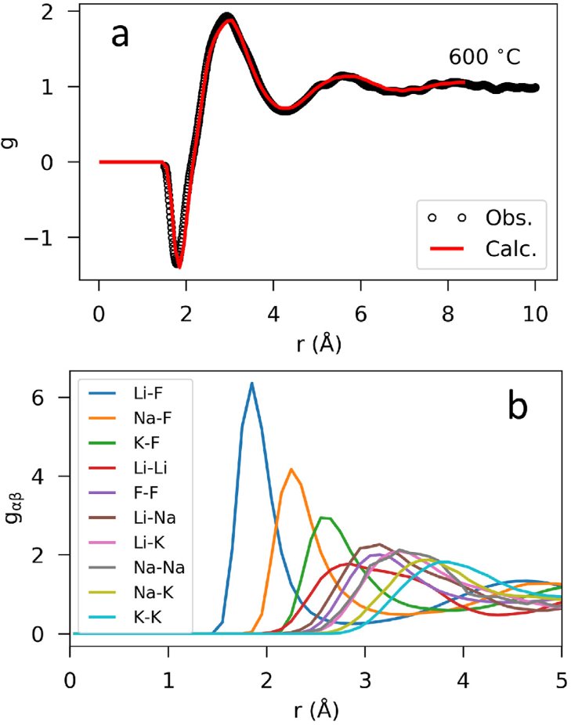
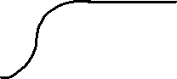
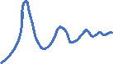
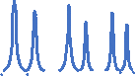
Pair Distribution Function
Short Range Liquid Structure
Liquids lack long-range periodicity of crystal, but have preferential arrangements at short distances.
The pair distribution function (PDF) gives the probability distribution of interatomic spacing—can be obtained from X-ray and neutron diffraction experiments.
The partial PDF gives the probabilities of separation distances for individual ion pairs—this is most often done using AIMD simulations and then validating with the total experimental PDF
Normalized by radial distance, the partial PDF provides the probability g_{AB}(r) of finding an ion B a distance r from reference ion A.
Can the PDF provide information about the mean free path of energy carriers?
g(r)
Solid Crystal
1
r
g(r)
Gas
1
r
g(r)
Liquid
1
(a) Experimental PDF and (b) modeled partial PDF of molten FLiNaK.
B. A. Frandsen et al. Journal of Nuclear Materials (2020)^{[2]}
r
[1] Smith, A.L., 2022. Structure-property relationships in actinide containing molten salts – A review: Understanding and modelling the chemistry of nuclear fuel salts. Journal of Molecular Liquids 360, 119426. https://doi.org/10.1016/j.molliq.2022.119426
[2] Frandsen, B.A., Nickerson, S.D., Clark, A.D., Solano, A., Baral, R., Williams, J., Neuefeind, J., Memmott, M., 2020. The structure of molten FLiNaK. Journal of Nuclear Materials 537, 152219. https://doi.org/10.1016/j.jnucmat.2020.152219
Notes:
I had the priviledge of helping conduct thermal conductivity measurements of NaCl-UCl3 using the variable gap apparatus, which was designed by Ryan Gallagher. It’s been developed by Nick Termini and the team at ORNL to include an extensive Helium calibration method to better characterize it’s measurements. Can provide large temperature range and a confident temperature due to its inherent variable gap design.
These measurements of a similar salt were also conducted using LFA at Argonne national laboratory, which obtains similar reference values at the melting temperature.
KT underestimates these for reasons we just discussed, but note how PGM matches closely with measurements.
Now, why does PGM underestimate pure alkali-halides and mixtures but appropriately predict higher concentrations of actinides? Again, the biggest assumption we think we make with PGM (and most models really) is in calculating the mean free path. PGM puts it simply at the interatomic distance, it may be that this becomes more accurate for complexing salts with actinides.
Obtaining more compositional studies of actinide salts that capture the temperature dependency is vital to answering these questions.

Slide 15
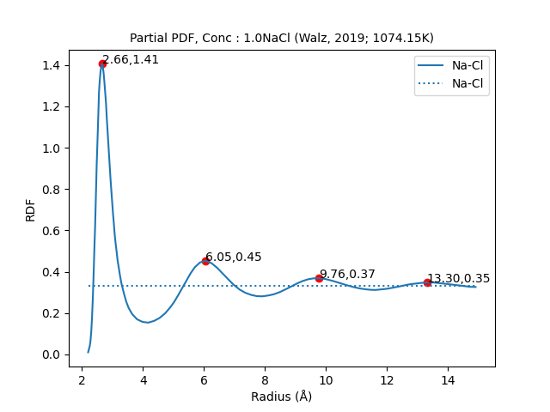
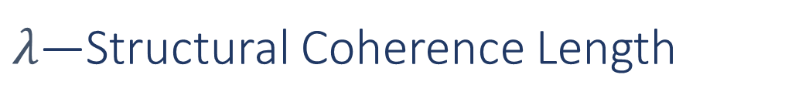
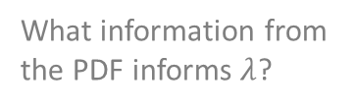
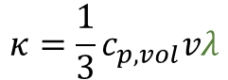
$λ\text{—}$Structural Coherence Length
Interpreting the Pair Distribution Function
Thermal energy transferred
Assumptions:
Cation-anion pairs are dominant medium in energy transfer (strongest bonds, charge-ordering).
Energy carriers (phonons, sequential ion collisions, etc.) will propagate as long as its medium remains coherent.
Structural coherence length is proportional the degree of short-range order in molten salts.
Energy must be redistributed wherever structural coherence ends
Bulk number density
Some portion continues to the extent of a coherent medium
Concentration of ion pair
Perfect decay function fitting indicates that mechanisms for coherence decay in first coordination shell continue with r.
How does coherence change with distance?
$$κ=\frac{1}{3}c_{p,vol}vλ$$
What information from the PDF informs $λ$?

Slide 16
$λ\text{—}$Structural Coherence Length
Interpreting the Pair Distribution Function
How does coherence change with distance?
Thermal energy transferred
Energy must be redistributed wherever structural coherence ends
Bulk number density
Rules for coherency:
The ideal recipients of energy carriers are oppositely charged ions separated by distance of interaction potential minima (most efficient transfer)
Decoherence results in the transfer of energy to system—new energy carriers
Interacting with a non-ideal recipient breaks coherence. Non-ideal recipients include:
Same-charge ions
Dissimilar next-ions from the originating ion
Out-of-phase transfer
Some portion continues to the extent of a coherent medium
Concentration of ion pair
$$κ=\frac{1}{3}c_{p,vol}vλ$$
What information from the PDF informs $λ$?

Slide 17
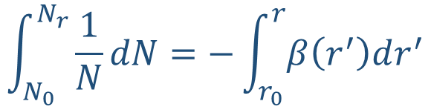
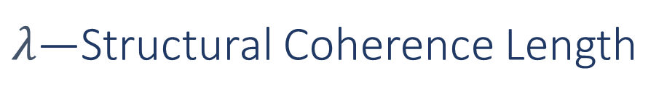
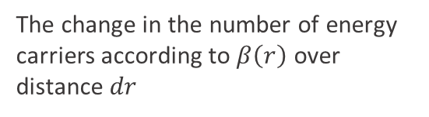
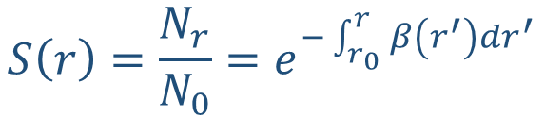
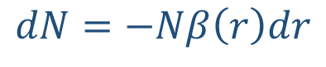
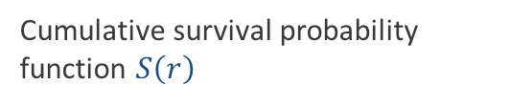
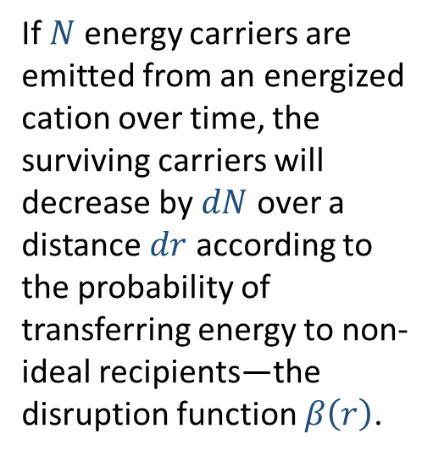
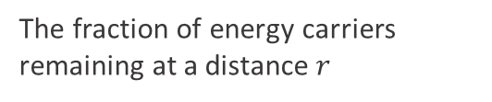
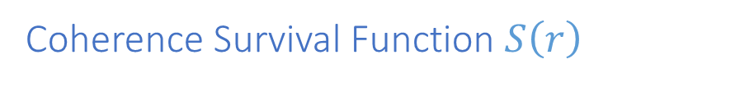
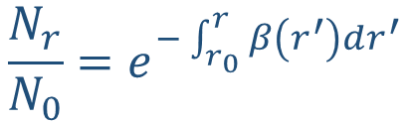
$λ\text{—}$Structural Coherence Length
Coherence Survival Function $S\left(r\right)$
If $N$ energy carriers are emitted from an energized cation over time, the surviving carriers will decrease by $dN$ over a distance $dr$ according to the probability of transferring energy to non-ideal recipients—the disruption function $β\left(r\right)$.
The change in the number of energy carriers according to $β\left(r\right)$ over distance $dr$
$$dN=−Nβ\left(r\right)dr$$
$$\int_{N_{0}}^{N_{r}}{\frac{1}{N}dN}=−\int_{r_{0}}^{r}{β\left(r^{′}\right)dr^{′}}$$
Rearranging and solving for the number of energy carriers as a function of radius
$$\frac{N_{r}}{N_{0}}=e^{−\int_{r_{0}}^{r}{β\left(r^{′}\right)dr^{′}}}$$
The fraction of energy carriers remaining at a distance $r$
$$S\left(r\right)=\frac{N_{r}}{N_{0}}=e^{−\int_{r_{0}}^{r}{β\left(r^{′}\right)dr^{′}}}$$
Cumulative survival probability function $S\left(r\right)$

Slide 18
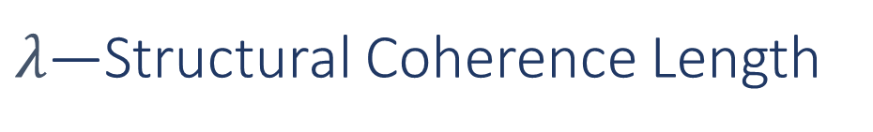
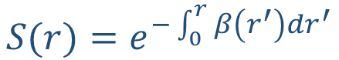
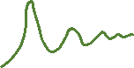
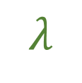

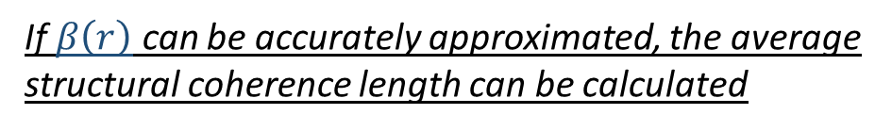
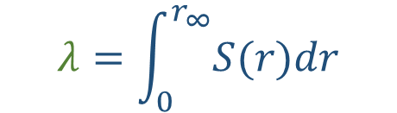

$λ\text{—}$Structural Coherence Length
Coherence Survival Function $S\left(r\right)$
g(r)
1
$$S(r)=e^{−\int_{0}^{r}{β\left(r^{′}\right)dr^{′}}}$$
Area under normalized cumulative survival function is the average distance of energy transfer—the average structural coherence length
r
S(r)
$$λ=\int_{0}^{r_{∞}}{S(r)dr}$$
Liquid
1
r
If $β\left(r\right)$ can be accurately approximated, the average structural coherence length can be calculated
$$λ$$

Slide 19
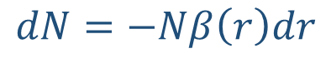
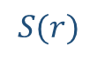

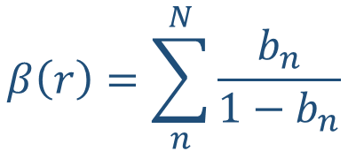
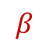
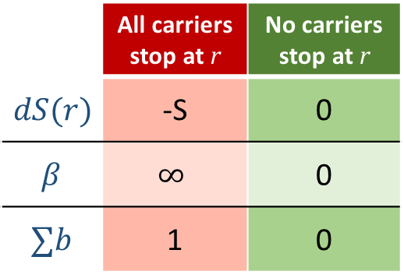
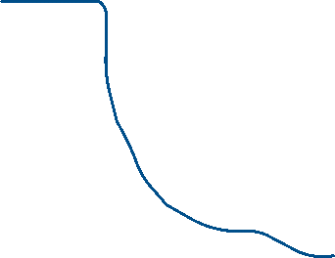





$λ\text{—}$Structural Coherence Length
Scaling Contributions to Decoherence
$$dN=−Nβ\left(r\right)dr$$
$dN$ is equal to $−N$ when $Nβ\left(r\right)dr=0$, or when $β\left(r\right)→∞$
$$β$$
$$S(r)$$
1
$$β\left(r\right)=\sum_{n}^{N}{\frac{b_{n}}{1−b_{n}}}$$
To not require an absolute value for decoherent factors ranging from 0 to ∞, we can define relative decoherence factors $b_{n}$as a ratio between 0 and 1, which either cause $β\left(r\right)→0$ or $∞$ for each limit.
 | All carriers stop at r | No carriers stop at r
$$dS(r)$$ | -S | 0
$$β$$ | $$∞$$ | 0
$$∑b$$ | 1 | 0
If multiple relative decoherence factors are present, then the sum of their expressions for $β\left(r\right)$ allow each to either cause $β\left(r\right)→∞$ or have no effect
$$∑b$$
r

Slide 20








$λ\text{—}$Structural Coherence Length
Disruption Function $β\left(r\right)$
$$r_{t,1}$$
Disruption factors $b_{i}$:
$$r_{t,2}$$
$$r_{t,3}$$
$$r_{t,4}$$
Calculated at discrete transfer radii $r_{t,n}$ because the ideal coherent medium is a sequential chain of cation-anion-cation-anion-etc. Assumes other interaction distances leads to decoherence.
The interval spacing for efficient transfer are given by the first peak distance for each cation-anion pair, corresponding to the energy minima^{[1]}.
Subsequent peaks are not determined by interaction potential with central ion—dictated by packing density
Most efficient separation distance for vibrational energy transfer. The first peak corresponds to the energy minima, so any other transfer position is assumed decoherent
[1] Hines, A.L., Walls, H.A., 1979. Determination of self diffusion coefficients using the radial distribution function. Metall Trans A 10, 1365–1370. https://doi.org/10.1007/BF02811992

Slide 21























$λ\text{—}$Structural Coherence Length
$$β\left({\left.r\right|}_{r_{t,i}}^{r_{t,i−2}}\right)=$$
$$∑\frac{b_{i}}{1−b_{i}}$$
Disruption Function $β\left(r\right)$
$$b_{NI}$$
$$b_{NI}$$
$$b_{NI}$$
$$b_{KF}$$
$$b_{KF}$$
$$b_{KF}$$
$$…$$
Disruption factors $b_{i}$:
$b_{NI}$: Non-ideal recipient probability factor
$b_{KF}$: Bond strength factor
$b_{PH}$: Phonon transfer factor
$$b_{PH}$$
$$b_{PH}$$
$$b_{PH}$$
$$b_{NI}=1 − \frac{g_{ideal}(r_{t,1})}{g_{total}(r_{t,1})}$$
$$r_{t,1}$$
$$r_{t,2}$$
$$r_{t,3}$$
$$r_{t,4}$$
$$b_{KF}=1 −\frac{g_{+−}\left(r_{p1}\right)−g_{+−}\left(r_{m1}\right)}{g_{+−}\left(r_{p1}\right)}$$
$$b_{PH}=1− \frac{x_{ca,i}}{∑x_{ca,i}}$$
+
-
+
-
+
Energy will travel at least the first bond distance—whether it continues past this point depends on the probability of coherency
The $b_{i}$ factors account for probability of decoherent events at each transfer distance
+
-
+

Slide 22





$λ\text{—}$Structural Coherence Length
Disruption Function $β\left(r\right)$
$$β\left(r\right)=\sum_{n}^{N}{\frac{b_{n}}{1−b_{n}}}$$
Summary:
Ideal coherence starts at an infinite chain of cation-anion-etc.
Perturbations from ideality drop the structural coherence length according to probabilities of non-coherence factors
The minimum path length is the transfer distance between the first cation-anion pair.
↑Why the effect of Umklapp scattering, 4-phonon scattering reaches max effect—no T³ temperature dependence.
$$S(r)=e^{−\int_{0}^{r}{β\left(r^{′}\right)dr^{′}}}$$
$$λ=\int_{0}^{r_{∞}}{S(r)dr}$$
$$\overline{λ}=\sum_{i}^{N}{x_{i}λ_{i}}$$
$$κ=\frac{1}{3}c_{p,vol}vλ$$
Further development will weight specific heat, speed of sound to estimate each ion pair’s relative contributions

Slide 23





Results
Compared to Back-Calculated $λ$
Analysis:
13 alkali/alkaline-earth halide salts were analyzed using experimental k and MD simulation PDF data from various literature sources.
Back-calculated structural coherence length provided initial comparisons to present model predictions
$$λ_{BC}=3\frac{k_{exp}}{c_{p,vol}v}$$
Further development will weight specific heat, speed of sound to estimate each ion pair’s relative contributions

Slide 24

Results
Comparison to Experimental Measurement
The present general energy carriers model performs well for range of salts.
Some discrepancy for divalent alkaline earth halide salts, but measurement data is limited.

Slide 25



Results
Model Comparison
The present model performs comparably well with Gheribi’s kinetic theory for unary and mixture salts
When no mixture data was available, the models used fundamental mixing rules for c_{p}, v, and density of the mixture.
“Mix Data” indicates models used the same measured values for speed of sound, specific heat, and density of the mixture

Slide 26
Results
Model Comparison
Present model better approximates actinide-bearing salt measurement data than kinetic theory.
Results support possible connection between bulk thermophysical properties and energy carrier properties

Slide 27

To Implement
Compared to Back-Calculated $λ$
Further Development to Implement
Data Needed
In non-unary salts, each cation-anion pair will contribute variably to specific heat and speed of sound—estimating these contributions will improve model accuracy.
Total thermal conductivity will be weighted sum of each pair’s effective contribution
PDFs for all halide unary salts, particularly unary actinide salts
PDFs for key actinide mixtures
Thermal conductivity measurements for more actinide bearing salt mixtures
Compositional studies around the eutectic point will point to trends b/w composition and k

Slide 28


Measurement Efforts
Experimental Validation
Modified Transient “Needle Probe”
Developed thermal conductivity measurement device at BYU
Requires minimal sample size and test duration, enabling higher throughput for compositional studies
Building new version to measure actinide-bearing salts at higher temperature range (≤1100°C)

Slide 29
Conclusions
Future Work
Molten salt thermophysical measurement and models need to develop together
Molten salts require all innovative measurements and robust models available
Liquid thermal theory could provide insights beyond molten salts
We need more measurements across compositions and temperatures, especially regarding actinide-bearing mixtures
Measure across compositions:
FLiNaK-UF₄
NaCl-UCl₃
CLiNaK system (LiCl-KCl)
Develop predictive thermal conductivity model for actinide-bearing salts
Measuring electrical conductivity to compare to increase in diffusivity with dual-purpose probe (Walz and Spoel, 2019, p. 18522)
Notes:
In summary, models and measurements need to grow up together. All methods are valuable, since non is standardized and each has advantages and limitations
Salts are challenging to measure and model, but these obstacles require innovate measurement methods and models—it’s a proving ground for liquid thermal theory that can extend beyond molten salts.
We need compositionally and temperature dependent data.
Our future measurements include compsitions of FLiNaK system with UF4 and the CLiNaK system, with validation of key mixtures via a collaboration with ORNL.
Our end goal is to provide/develop confident thermal conductivity characterization for actinide bearing salts.

Slide 30


Acknowledgements
Funding for this research has come from the Department of Energy, Nuclear Energy University Program (NEUP): Award #DE-NE0009502.
Anthony Birri and Nicholas Termini are supported by the Molten Salt Reactor Program and the Nuclear Energy Advanced Modeling and Simulation Program under the US Department of Energy’s Office of Nuclear Energy.
Meaningful discussions with Benjamin Frandsen and Matthew Asplund also provided valuable direction for the project. The authors are also grateful for the assistance of Tyler Hamm, Britton Baltich, Isaac Cutler, and Lizzy Robinson in compiling and interpreting data for this work.
Presentation slides

Slide 31
References
Oak Ridge National Laboratory, U. of South Carolina, T. Besman, N. D. B. Ezell, T. Birri, N. Termini, S. Henderson, and J. Schorne-Pinto. (2024) Molten salt thermal properties database. [Online]. Available: https://mstdb.ornl.gov/
Creasman, Sarah. “Sensitivity Analysis of Thermophysical Properties of Molten Salts Using a Molten Salt Demonstration Reactor Model in TRANSFORM.” Doctoral Dissertations, May 1, 2023. https://trace.tennessee.edu/utk_graddiss/8160.
Freile, Ramiro, and Mark Kimber. “Influence of Molten Salt-(FLiNaK) Thermophysical Properties on a Heated Tube Using CFD RANS Turbulence Modeling of an Experimental Testbed.” Edited by Jan Leen Kloosterman, Elsa Merle, and Jean Ragusa. EPJ Nuclear Sciences & Technologies 5 (2019): 16. https://doi.org/10.1051/epjn/2019027.
Golyshev, Vladimir D. “Experimental Investigation of the Thermal-Conductivity of Transparent Melts”, TVT, 21:5 (1983), 899–903; High Temperature, 21:5 (1983), 684–687,” 1983. https://www.mathnet.ru/php/archive.phtml?wshow=paper&jrnid=tvt&paperid=6160&option_lang=eng.
Golyshev, Vladimir D. “High-Temperature Thermophysical Properties of Nonscattering Semitransparent Materials I: Methods and Instrumentation for the Determination of Spectral Absorptivity and Thermal Conductivity of Melts,” no. 4 (1992): 367–77.
Khlebnikov, O. E., V. A. Sokolov, I. E. Veneraki, and A. N. Alabovsky. “Determination of Thermal Conductivity Coefficients of Lithium, Magnesium, Calcium, and Barium Fluorides in the Liquid State.” Thermophysical Properties of Substances 5 (1981): 97–101.
Harada, Makoto, Akihisa Shioi, Tsunetoshi Miura, and Shinsuke Okumi. “Thermal Conductivities of Molten Alkali Metal Halides.” Industrial & Engineering Chemistry Research 31, no. 10 (October 1, 1992): 2400–2407. https://doi.org/10.1021/ie00010a021.
Nagasaka, Y., and A. Nagashima. “Measurement of the Thermal Diffusivity of Molten KCl up to 1000°C by the Forced Rayleigh Scattering Method.” International Journal of Thermophysics 9, no. 6 (November 1, 1988): 923–31. https://doi.org/10.1007/BF01133260.
An, Xue-Hui, Jin-Hui Cheng, Hui-Qin Yin, Lei-Dong Xie, and Peng Zhang. “Thermal Conductivity of High Temperature Fluoride Molten Salt Determined by Laser Flash Technique.” International Journal of Heat and Mass Transfer 90 (November 1, 2015): 872–77. https://doi.org/10.1016/j.ijheatmasstransfer.2015.07.042.
Gallagher, Ryan C., Anthony Birri, Nick G. Russell, Anh-Thu Phan, and Aïmen E. Gheribi. “Investigation of the Thermal Conductivity of Molten LiF-NaF-KF with Experiments, Theory, and Equilibrium Molecular Dynamics.” Journal of Molecular Liquids 361 (September 1, 2022): 119151. https://doi.org/10.1016/j.molliq.2022.119151.
Khokhlov, V., I. Korzun, V. Dokutovich, and E. Filatov. “Heat Capacity and Thermal Conductivity of Molten Ternary Lithium, Sodium, Potassium, and Zirconium Fluorides Mixtures.” Journal of Nuclear Materials 410, no. 1 (March 1, 2011): 32–38. https://doi.org/10.1016/j.jnucmat.2010.12.306.
Merritt, Brian, Michael Seneca, Ben Wright, Noah Cahill, Noah Petersen, Austin Fleming, and Troy Munro. “Thermal Conductivity Characterization of Fluoride and Chloride Molten Salts Using a Modified Transient Hot-Wire Needle Probe.” International Journal of Thermophysics 43, no. 10 (August 10, 2022): 149. https://doi.org/10.1007/s10765-022-03073-2.
Nagasaka, Y., N. Nakazawa, and A. Nagashima. “Experimental Determination of the Thermal Diffusivity of Molten Alkali Halides by the Forced Rayleigh Scattering Method. I. Molten LiCl, NaCl, KCl, RbCl, and CsCl.” International Journal of Thermophysics 13, no. 4 (July 1, 1992): 555–74. https://doi.org/10.1007/BF00501941.
Robertson, Sean G., Ralph Wiser, Wonseok Yang, Dokyu Kang, Sungyeol Choi, Emilio Baglietto, and Michael P. Short. “The Curious Temperature Dependence of Fluoride Molten Salt Thermal Conductivity.” Journal of Applied Physics 131, no. 22 (June 8, 2022): 225102. https://doi.org/10.1063/5.0088059.
Rudenko, Alexey, Alexander Redkin, Evgeniya Il’ina, Svetlana Pershina, Peter Mushnikov, Yuriy Zaikov, Sergey Kumkov, Yalan Liu, and Weiqun Shi. “Thermal Conductivity of FLiNaK in a Molten State.” Materials 15, no. 16 (January 2022): 5603. https://doi.org/10.3390/ma15165603.
Smirnov, M. V., V. A. Khokhlov, and E. S. Filatov. “Thermal Conductivity of Molten Alkali Halides and Their Mixtures.” Electrochimica Acta 32, no. 7 (July 1, 1987): 1019–26. https://doi.org/10.1016/0013-4686(87)90027-2.
V. I. Fedorov, V. I. Machuev, “Thermal Conductivity of Fused Salts”, TVT, 8:4 (1970), 912–914; High Temperature, 8:4 (1970), 858–860. Accessed March 23, 2024. https://www.mathnet.ru/php/archive.phtml?wshow=paper&jrnid=tvt&paperid=7779&option_lang=eng.
Frandsen, Benjamin A., Stella D. Nickerson, Austin D. Clark, Andrew Solano, Raju Baral, Johnny Williams, Jörg Neuefeind, and Matthew Memmott. “The Structure of Molten FLiNaK.” Journal of Nuclear Materials 537 (August 15, 2020): 152219. https://doi.org/10.1016/j.jnucmat.2020.152219.
Giordano, Valentina M., and Giulio Monaco. “Fingerprints of Order and Disorder on the High-Frequency Dynamics of Liquids.” Proceedings of the National Academy of Sciences 107, no. 51 (December 21, 2010): 21985–89. https://doi.org/10.1073/pnas.1006319107.
Revere, M., and M. P. Tosi. “Structure and Dynamics of Molten Salts.” Reports on Progress in Physics 49, no. 9 (September 1986): 1001. https://doi.org/10.1088/0034-4885/49/9/002.
Cahill, David G., S. K. Watson, and R. O. Pohl. “Lower Limit to the Thermal Conductivity of Disordered Crystals.” Physical Review B 46, no. 10 (September 1, 1992): 6131–40. https://doi.org/10.1103/PhysRevB.46.6131.
Gheribi, A.E., A.T. Phan, and P. Chartrand. “A Theoretical Framework for Reliable Predictions of Thermal Conductivity of Multicomponent Molten Salt Mixtures: KCl-NaCl-MgCl2 as a Case Study.” Solar Energy Materials and Solar Cells 236 (2022). https://doi.org/10.1016/j.solmat.2021.111478.
Gheribi, Aïmen E., and Patrice Chartrand. “Thermal Conductivity of Molten Salt Mixtures: Theoretical Model Supported by Equilibrium Molecular Dynamics Simulations.” The Journal of Chemical Physics 144, no. 8 (February 26, 2016): 084506. https://doi.org/10.1063/1.4942197.
Gheribi, Aïmen E., Jesus A. Torres, and Patrice Chartrand. “Recommended Values for the Thermal Conductivity of Molten Salts between the Melting and Boiling Points.” Solar Energy Materials and Solar Cells 126 (July 1, 2014): 11–25. https://doi.org/10.1016/j.solmat.2014.03.028.
Kincaid, John F., and Henry Eyring. “Free Volumes and Free Angle Ratios of Molecules in Liquids.” The Journal of Chemical Physics 6, no. 10 (October 1, 1938): 620–29. https://doi.org/10.1063/1.1750134.
Nagasaka, Y., and A. Nagashima. “Corresponding States Correlation for the Thermal Conductivity of Molten Alkali Halides.” International Journal of Thermophysics 14, no. 4 (July 1, 1993): 923–36. https://doi.org/10.1007/BF00502115.
Yang, Huiqiang, Ryan Gallagher, Patrice Chartrand, and Aïmen E. Gheribi. “Development of a Molten Salt Thermal Conductivity Model and Database for Advanced Energy Systems.” Solar Energy 256 (May 15, 2023): 158–78. https://doi.org/10.1016/j.solener.2023.04.009.
Zhao, Andrew Z., Matthew C. Wingert, Renkun Chen, and Javier E. Garay. “Phonon Gas Model for Thermal Conductivity of Dense, Strongly Interacting Liquids.” Journal of Applied Physics 129, no. 23 (June 21, 2021). https://doi.org/10.1063/5.0040734.
Chliatzou, Ch. D., M. J. Assael, K. D. Antoniadis, M. L. Huber, and W. A. Wakeham. “Reference Correlations for the Thermal Conductivity of 13 Inorganic Molten Salts.” Journal of Physical and Chemical Reference Data 47, no. 3 (September 19, 2018): 033104. https://doi.org/10.1063/1.5052343.
Zhao, Andrew Z., Matthew C. Wingert, and Javier E. Garay. “Frequency-Domain Hot-Wire Measurements of Molten Nitrate Salt Thermal Conductivity.” Journal of Chemical & Engineering Data 66, no. 1 (January 14, 2021): 262–70. https://doi.org/10.1021/acs.jced.0c00621.
Bobrova, K. O., V. N. Dokutovich, and P. N. Mushnikov. “Thermophysical Properties of Several Molten Mixtures of the LiF–BeF2–UF4 System.” Russian Metallurgy (Metally) 2023, no. 2 (February 1, 2023): 126–35. https://doi.org/10.1134/S0036029523020039.
Rose, M. A., L. D. Gardner, T. T. Lichtenstein, S. A. Thomas, and E. Wu. “Property Measurements of NaCl-UCl3 and NaCl-KCl-UCl3 Molten Salts (Rev.1).” Argonne National Laboratory (ANL), Argonne, IL (United States), May 26, 2023. https://doi.org/10.2172/1985295.
Termini, N. Birrit, T. Ezell, D. [Forthcoming] “Thermal conductivity measurements of NaCl-UCl3 using the variable gap apparatus.” Oak Ridge National Laboratory (ORNL), Oak Ridge, TN (United States). April, 2023.
Q. Zheng, M. Hao, R. Miao, J. Schaadt, and C. Dames, “Advances in thermal conductivity for energy applications: a review,” vol. 3, no. 1, p. 012002, publisher: IOP Publishing. [Online]. Available: https://dx.doi.org/10.1088/2516-1083/abd082
Chen, Gang. “Perspectives on Molecular-Level Understanding of Thermophysics of Liquids and Future Research Directions.” Journal of Heat Transfer 144, no. 010801 (November 9, 2021). https://doi.org/10.1115/1.4052657.
Trachenko, Kostya. “Heat Capacity of Liquids: An Approach from the Solid Phase.” Physical Review B 78, no. 10 (September 5, 2008): 104201. https://doi.org/10.1103/PhysRevB.78.104201.

Slide 32
Additional Slides

Slide 33





Needle Probe
Solves multi-layer heat diffusion equation for λ and c_{p} (and ρ if needed) to fit the analytical model to the temperature profile
Can select time frame for the fitting process according to regime most influenced by sample properties (from COMSOL sensitivity analysis)
Thermal quadrupoles to solve heat diffusion equations
Transform to Laplace space for solvable algebra
Solve for Laplace heat rate with Bessel functions
Adapt for layers system of equations
Numerically solve for sample properties to fit the analytical temperature to the temperature profile
λ_{sample}, c_{p,sample}, ρ_{sample}
Notes:
Merritt, Maillett

Slide 34






Modeling Actinides
Gheribi - Kinetic Theory
KT methods build compositional dependency using a modifier to ideal conductivity, with a factor of mass fluctuation
$$λ(X,T)=λ_{σ}(X,T)\left[1−δ_{M}^{λ}(X,T)\right]$$
$$g_{mass}=\sum_{i=0}^{N}{X_{i}∗{\left[\frac{m_{i}}{\overline{m}}−1\right]}^{2}}$$
KT performs well with ions of similar molar masses, but degrades with increasing disparity of molar mass, providing unrealistic estimations for actinides
FLiBe
FLiBe+2%UF₄
$$g=0.09$$
$$g=1.45$$
PGM underpredicts most λ, but approaches measured value with increased actinide presence. Why?
What we need:
More actinide data with compositional/temperature variation
Develop modeling ability for actinides
M_{UF4} = 314 g/mol
M_{LiF} = 25.9 g/mol
^{Reference 31}
Notes:
Lattice thermal conductivity degradation may include other significant factors in addition to mass variation.
To extend predictive models to actinide-bearing mixtures, these must be developed to handle large molecular mass differences.

Slide 35



Model Performance
Comparison of FLiNaK model predictions using mixture values obtained via measurements or fundamental mixing rules.
Does the variation in model results sufficiently replicate measurement uncertainty?
KT uses fundamental mixing rules for property values (C_{p}, V_{m}, v_{sound})(cite Gallagher). These are applied to PGM for analysis.
M_{m} and v_{sound} dominant influential parameters in both Gheribi and Zhao models; molten salt sound velocity values are subject to significant uncertainty.
Gheribi’s Cahill-Poll λ_{min} provides best parameter sensitivity confinement
%Deviation of estimated properties using mixing rules from measured values for eutectic FLiNaK
 | KT_{emp} |  | KT_{CP} | PGM
v_{sound,m} | 15% |  |  | -2.1%
v’_{sound} (slope) |  |  |  | 21%
V_{m} | -15% |  |  | -1.3%
V’ (slope) |  |  |  | 14%
C_{p} | 15% |  |  | 15%
^{See reference 10}

Slide 36












Review - Kinetic Theory
Kinetic theory model works for ideal gases because there exists only one type of energy carrier with measurable average attributes (number density, velocity, volumetric heat capacity).
For generalized energy carriers, the problem becomes how to characterize and measure energy carriers.
Generalized Energy Carriers
Unit area
dA
Unit distance
dx
Unit distance travelled in unit time 𝑑𝑡 at average velocity ⟨𝑣⟩
$$dx=\left\langle v\right\rangle dt$$
Number density
$$n=\frac{\# energy carriers}{unit volume}$$
Unit volume in terms of average velocity
$$dV=dA⋅dx$$
x
$$dV=dA\left\langle v\right\rangle dt$$
y
z
Number of energy carriers (particles, phonons, etc.) that will cross plane of unit area $dA$ per unit time $dt$
$$N_{transfer}=\frac{n}{6}⋅dV⋅\frac{1}{dA}⋅\frac{1}{dt}$$
1/3 of particles will have motion in any given direction
$$\frac{1}{3}$$
$$\frac{1}{3}$$
$$\frac{1}{3}$$
x
y
z
$$N_{transfer}=\frac{n}{6}\frac{dA\left\langle v\right\rangle dt}{dA dt}$$
+x
-x
$$N_{transfer}=\frac{n\left\langle v\right\rangle }{6}$$
1/6 will be moving towards surface $dA$
$$\frac{1}{6}$$
$$\frac{1}{6}$$

Slide 37











Review - Kinetic Theory
Change in energy across unit plane per unit time—heat flux $q$
$$q={\left.\frac{n\left\langle v\right\rangle }{6} dE\right|}_{x+λ}^{x−λ}$$
Generalized Energy Carriers
Energy change proportional to definition of internal energy
$$dE∝dU=CdT$$
$$q=\frac{n\left\langle v\right\rangle }{6}C\left(T_{x+λ}−T_{x−λ}\right)$$
Mean free path before collision (energy transfer)
Hot
$$q=\frac{n\left\langle v\right\rangle }{6}C\left(T_{x}−\frac{∂T}{∂x}λ−T_{x}−\frac{∂T}{∂x}λ\right)$$
Taylor series of $T\left(x∓λ\right)$ about $x$
x+λ
x=0
$$q=−\frac{1}{3}Cn\left\langle v\right\rangle λ\frac{∂T}{∂x}$$
x-λ
$$c_{p}$$
Volumetric constant pressure specific heat capacity
x
$$q=−\frac{1}{3}c_{p}\left\langle v\right\rangle λ\frac{∂T}{∂x}$$
Heat flux $q$ in terms temperature gradient
Cold
y
z
Thermal conductivity in terms of energy carrier properties
$$κ=\frac{1}{3}c_{p}\left\langle v\right\rangle λ$$
To define $κ$, we need to characterize the effective heat capacity, group velocity, and mean free path of the energy carriers.

Slide 38



$λ\text{—}$Structural Coherence Length
Disruption Function $β\left(r\right)$
$$r_{t,1}$$
Disruption factors $b_{i}$:
$b_{NI}$: Non-ideal recipient probability factor
Chances of interacting with a like-charge ion instead of ideal oppositely charged ion (typically very small due to charge ordering).
$$b_{NI}=1 − \frac{g_{ideal}(r_{t,1})}{g_{total}(r_{t,1})}$$
Dependent only on the first peak, which is gives the probability distribution around any ion in the chain.
Accounts for the potential decoherence caused by non-deal recipient ions
Most efficient separation distance for vibrational energy transfer.
Applied starting at second transfer $r_{t,2}$

Slide 39





$λ\text{—}$Structural Coherence Length
Disruption Function $β\left(r\right)$
$$r_{p1}$$
Disruption factors $b_{i}$:
$b_{NI}$: Non-ideal recipient probability factor
$b_{KF}$: Bond strength factor
Subsequent peaks are not determined by interaction potential with central ion—dictated by packing density
$$b_{KF}=1 −\frac{g_{+−}\left(r_{p1}\right)−g_{+−}\left(r_{m1}\right)}{g_{+−}\left(r_{p1}\right)}$$
Ratio between 0 (bond allows no ions to escape) and 1 (no interaction between ions).
This accounts for the potential inefficiency of energy transfer across a cation-anion pair
Applied starting at second transfer $r_{t,2}$
$$r_{m1}$$
Non-zero first minima indicates relative affinity for diffusion
High ratio of peak height to first minima corresponds to very strong bond

Slide 40











$λ\text{—}$Structural Coherence Length
$$ω=\sqrt{\frac{k}{μ}}$$
Harmonic oscillator frequency function of bond strength $k$ and reduced mass $μ$
Disruption Function $β\left(r\right)$
Disruption factors $b_{i}$:
$b_{NI}$: Non-ideal recipient probability factor
$b_{KF}$: Bond strength factor
$b_{PH}$: Phonon transfer factor
Relative bond strength given by peak-minima ration, exponent simulating the Leonard-Jones potential attractive term
$$k∝R_{i}={\left(\frac{g_{ca,i}\left(r_{t1}\right)−g_{ca,i}\left(r_{m1}\right)}{g_{ca,i}\left(r_{p1}\right)}\right)}^{6}$$
$$μ=\frac{m_{c,i}m_{a}}{m_{c,i}{+m}_{a}}$$
Reduced mass of cation-anion pair $i$
$$b_{PH}=1− \frac{x_{ca,i}}{∑x_{ca,i}}$$
Decoherence induced proportional to concentration of ion pair $x_{ca,i}$
$$ω∝F_{ω,i}=\sqrt{\frac{R_{i}}{μ}}$$
Relative proportional frequency factor
Ratio of encountering ion other than given ion pair.
This accounts for the potential inability of an ion chain to sustain a phonon—requires at least 3 ions
Applied starting at third transfer $r_{t,3}$
For $\frac{F_{ω,i}}{{∑F}_{ω,i}} \left\{\begin{matrix}=1 & b_{PH}=0 \\ ≠1 & b_{PH}=1\end{matrix}\right.$
Assuming out-of-phase phonons cannot be sustained

Slide 41
$λ\text{—}$Structural Coherence Length
Disruption Function $β\left(r\right)$
Disruption factors $b_{i}$:
$b_{NI}$: Non-ideal recipient probability factor
$b_{KF}$: Bond strength factor
$b_{PH}$: Phonon transfer factor
$$b_{PH}=1− \frac{x_{ca,i}}{∑x_{ca,i}}$$
+
-
+
Ion sequence of similar masses/bond strength can sustain coherent longitudinal wave
Ratio of encountering ion other than given ion pair.
This accounts for the potential inability of an ion chain to sustain a phonon—requires at least 3 ions
Applied starting at third transfer $r_{t,3}$
+
-
+
Dissimilar ions cannot sustain minimum vibrational mode; transfer ends at first ion

Slide 42



$λ\text{—}$Structural Coherence Length
Continuous approaches
Errors:
Calculated the function $β\left(r\right)$ by simply taking continuous difference of ideal to non-ideal recipient PDFs
This doesn’t scale the disruption function physically, and sequential vibrations do not pass through every point. Their jumps are quantized.
Assumed that the subsequent peaks corresponded to energy potential minimum with respect to the reference ion, but these are dictated by packing density.
The ideal transfer distance will still be the first cation-anion peak position, though subsequent chains will be weighted by probabilities of aligned ions with r
Attempts to improve model:
Base everything off of relative quantities to avoid having to make empirical calculations
Discretize vibrational energy transfer jumps
Account for potential diffusion to decrease vibrational transfer efficiency and extend reach of final transfer
Need to weight specific heat and speed of sound contributions for each ion pair for final thermal conductivity calculation

Slide 43






$λ\text{—}$Structural Coherence Length
$$P(r)=e^{−\int_{0}^{r_{max}}{β\left(r\right)dr}}$$
Continuous $β\left(r\right)$- Comparison to Measurement
Further perturbations can be added to 𝛽(𝑟) to account for additional factors of coherency.
Maximum possible initial energy carriers transferred (by first peak height)
Change in energy transfer efficiency—highly dependent on ion separation distance (though the PDF does implicitly maximize 𝛽(𝑟) between ions, resembling the increased decay rate)
Challenges:
Potential for "rebounded" energy carriers, where no recipient is in position to receive the carrier.
Does not capture behavior of multiple cation-anion pairs in mixtures
Model prediction of $λ_{P(r)}$ exceeds the back-calculated values $λ_{BC}$ of unary alkali halide salts by 3-20%
May be estimated by the combined Debye-modified Coulomb and Leonard-Jones potential
The cumulative integral interaction function $β\left(r\right)$ can then be used to describe the decay of energy carriers according to the SRO given by the PDF.

